Slide 1
Object Detection Networks on Convolutional Feature Maps
Shaoqing Ren Kaiming He Ross Girshick Xiangyu Zhang Jian Sun
Microsoft Research
Ph.D in School of Information Science and Technology in the University of Science and Technology of China. I'm in a joint Ph.D program between University of Science and Technology of China and Microsoft Research Asia.
His research interest includes computer vision and machine learning. Specially, detection and localization of face and general object.

Slide 2

Object Detection NoCs
Overview
Introduction
Related work
NoCs
Experiments

Slide 3
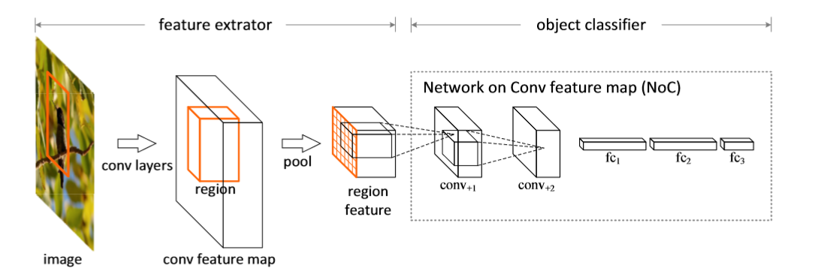
object detectors
a feature extractor
an object classiﬁer

Slide 4

Object Detection NoCs
Overview
Introduction
Related work
NoCs
Experiments

Slide 5

Introduction
HOG/SIFT/LBP + SVM(DPM)
object detectors
deep ConvNets +SVM(DPM)
R-CNN +SVM(DPM)
Now strategy for object detection : use a pre-trained deep ConvNet for feature extraction(with or withoutﬁne-tuning)followed by a ﬁne-tuned MLP for classiﬁcation.

Slide 6
(1)Can we design a better region classiﬁer for detection than an MLP?
(2) How important is ﬁne-tuning for region classiﬁcation?

Slide 7

Object Detection NoCs
Overview
Introduction
Related work
NoCs
Experiments

Slide 8
Related work
1.Traditional Object Detection: have said above
2.Convolutional Feature Maps：
Convolutional layersn can be applied to images of arbitrary size yielding proportionally sized feature maps.
3.Experimental Setting：
1）Data seting: (i)the original trainval set of 5k images in VOC 2007, and (ii) an augmented set of 16k images that consists of VOC 2007 trainval images and VOC 2012 trainval images

Slide 9
2）Pre-trained Models:
(i)adopt deep CNNs pre-trained on the 1000-class ImageNet dataset as feature extractors
(ii) At object classiﬁer stage investigate Zeiler and Fergus’s (ZF) model [32] and VGG models [26].

Slide 10

Object Detection NoCs
Overview
Introduction
Related work
NoCs
Experiments

Slide 11

Networks on Convolutional feature Maps
NoC as an MLP
NoC as a ConvNet
Maxout for Scale Selection
Fine-tuning
Using Very Deep Pre-trainedModels
Error Analysis

Slide 12
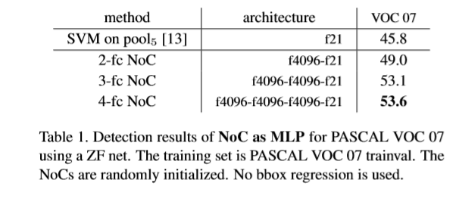
NoC as an MLP
A simple design of NoC is to use only fc layers, known as a multi-layer perceptron (MLP)
We investigate using 2 to 4 fc layers.

Slide 13
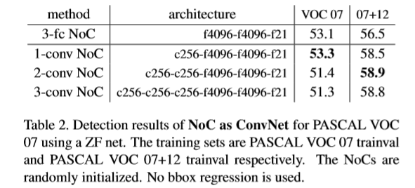
NoC as a ConvNet
We investigate using 1 to 3 additional conv layers. All conv layers are followed by ReLUs. We use 256 ﬁlters for the ZF net and 512 for the VGG net, which is equal to the ﬁlter number of the last conv layer in the pre-trained models

Slide 14
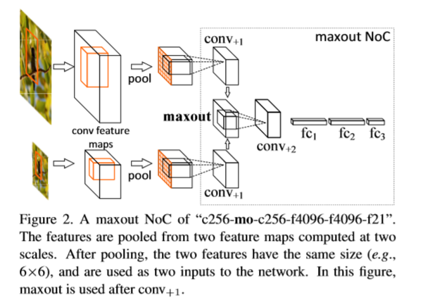
Maxout for Scale Selection
Author incorporate a local competition operation (maxout) [12] into NoCs to improve scale selection from the feature pyramid.

Slide 15
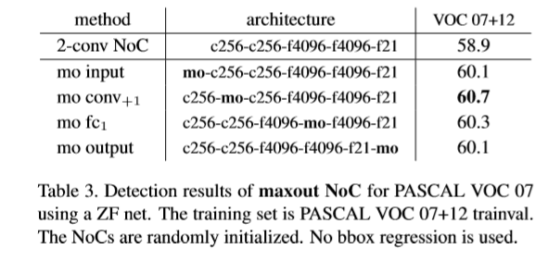
Maxout for Scale Selection

Slide 16
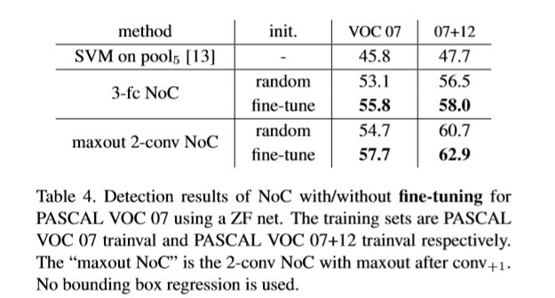
Fine-tuning
The comparisonofrandominitializationvs.ﬁne-tuningprovides new insights into the impacts of the well established ﬁnetuning strategy [9].

Slide 17
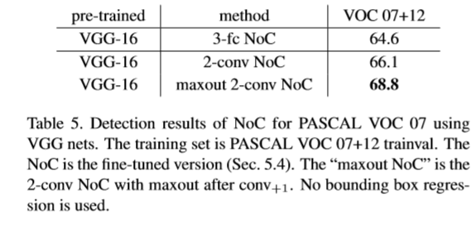
Using Very Deep Pre-trained Models
We ﬁnd that our NoCs also enjoy beneﬁts from deeper pre-trained models [26], and a deep classiﬁer is complementary to pre-trained very deep features

Slide 18
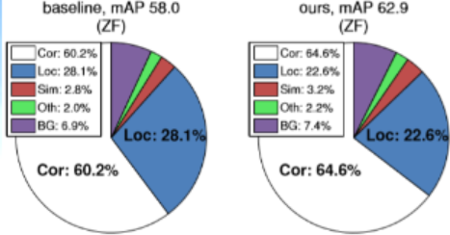
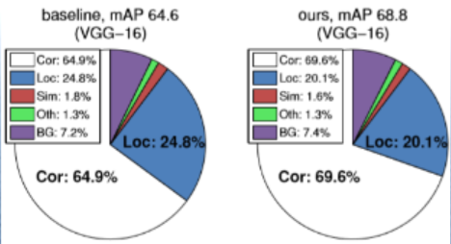
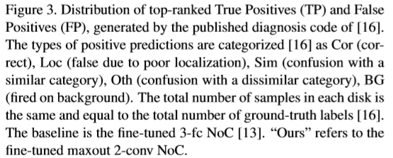
Error Analysis

Slide 19

Object Detection NoCs
Overview
Introduction
Related work
NoCs
Experiments

Slide 20

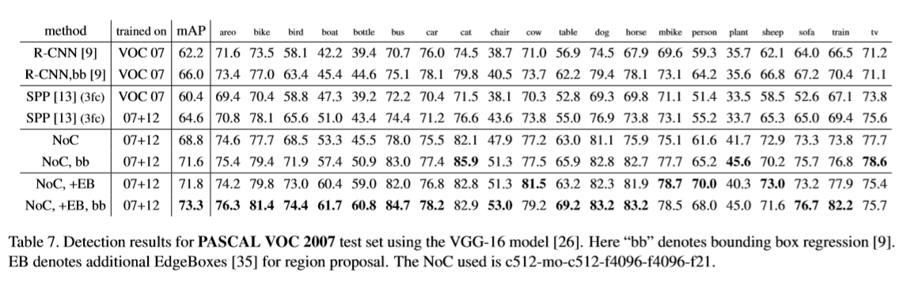
Experiments

